Slide 1
INTERNET AND WEB TECHNOLOGY LAB(IT-652)
GROUP NO. 20
ROLL NO.:
14/IT/21
14/IT/31
14/IT/51
DATE:18/01/17

Slide 2
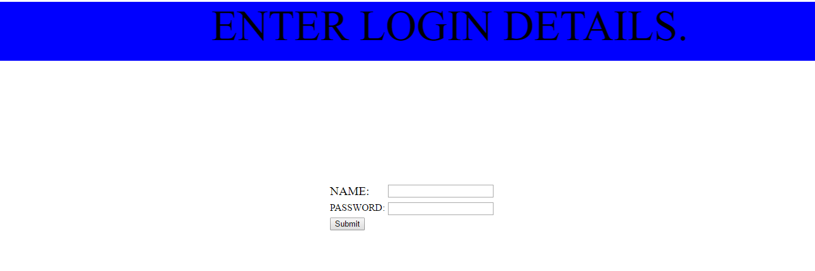
PROJECT NAME:LOGIN PAGE (SNAPSHOT OF LOGIN PAGE)

Slide 3
HTML CODE:
<!DOCTYPE HTML>
<html>
<head>
<title>Test Page</title>
<style>
.new{
background: #0000FF;
text-align: center;
font-size: 70px;
}
</style>
</head>

Slide 4
<body>
<div id="login_form">
<div class ="new"><marquee direction="left">ENTER LOGIN DETAILS.</marquee></div>
<center>
<form >
<table style="Margin-top:200px;">
<tr>
<td style="font-size: 20px">NAME:</td>
<td><input type="text" name="name" required="true"></td>
</tr>
<tr>
<td>PASSWORD:</td>
<td style="font-size: 20px"><input type="password" name="pswd" required="true">
</td>
</tr>
<tr>
<td><input type="submit" value="Submit"></td>
</tr>
</table>
</form>
</center>
</div>
</div>
</body>
</html>

Slide 5
TASK FOR NEXT WEEK(25/01/17):
1.Home Page
2.Login Page

Slide 6
Day 2 Date:25-1-17

Slide 7
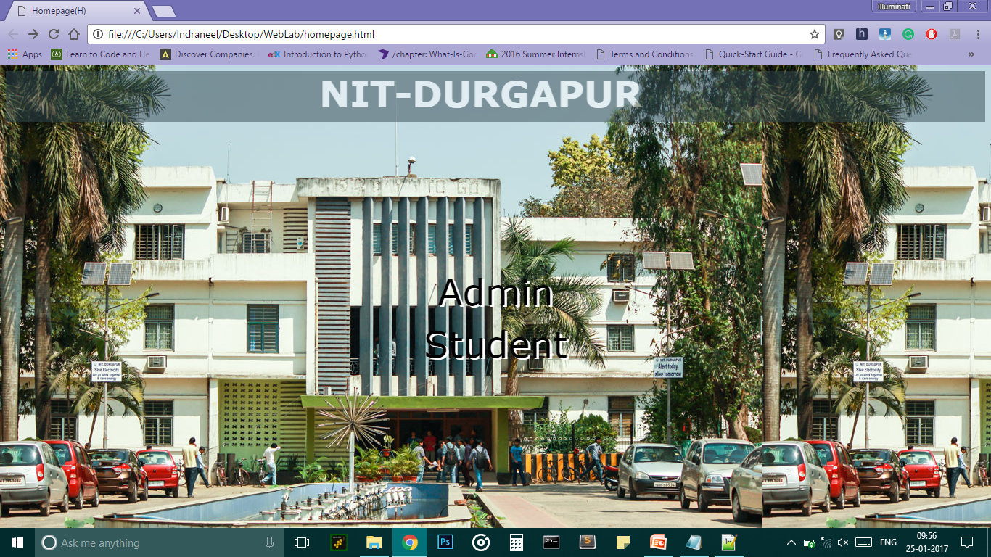
HOME PAGE

Slide 8
ADMIN LOGIN

Slide 9
TASKS TO BE COMPLETED 08/02/17
CREATE HTML REGISTRATION PAGE OF ADMIN
CREATE CSS REGISTRATION PAGE OF ADMIN
CREATE HTML STUDENT LOGIN PAGE

Slide 10
DAY 3: DATE:- 08/02/17
Roll no:
14/IT/21
14/IT/31
14/IT/51

Slide 11
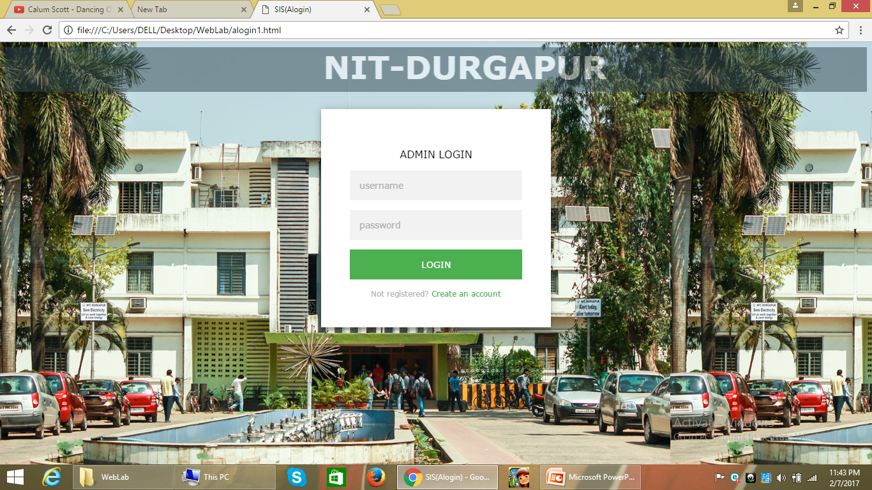
ADMIN LOGIN

Slide 12
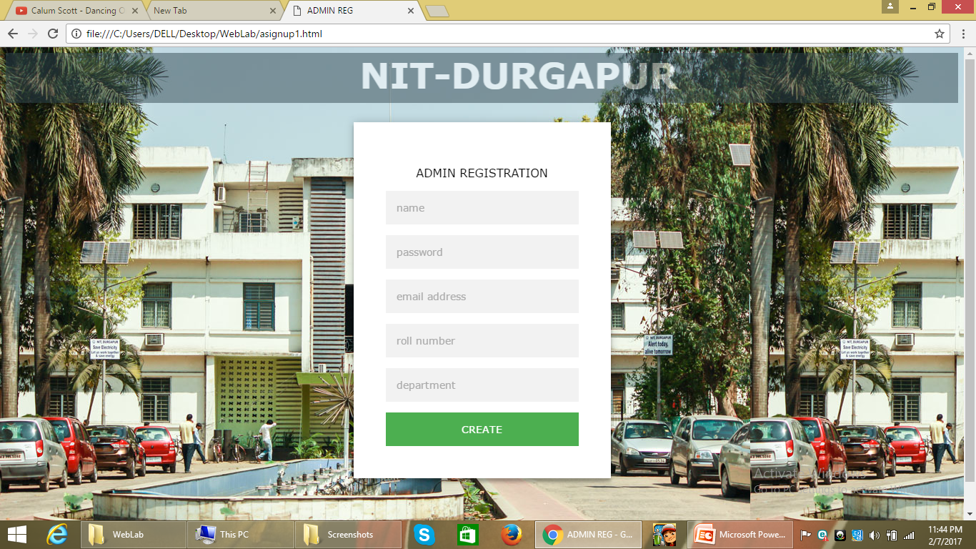
ADMIN REGISTRATION

Slide 13
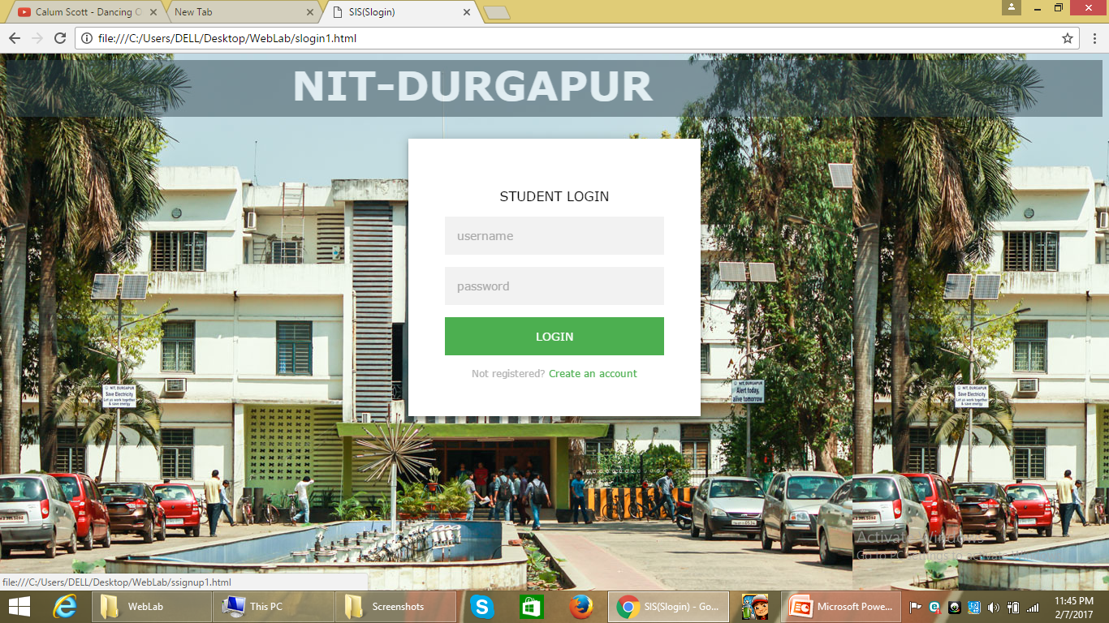
STUDENT LOGIN

Slide 14
WORK DISTRIBUTION
14/IT/21
ADDED HTML OF ADMIN REGISTRATION PAGE
ADDED CSS OF ADMIN REGISTRATION PAGE

Slide 15
WORK DISTRIBUTION
14/IT/31
ADDED HTML PAGE OF STUDENT LOGIN
CREATED PRESENTATION

Slide 16
WORK DISTRIBUTION
14/IT/51
CREATED ADDED HTML AND CSS STYLING OF HOMEPAGE AND LOGIN PAGE.

Slide 17
Tasks to be completed next week (15/02/17)
FORM VALIDATION
CREATE DISPLAY PAGE FOR ADMIN LOGIN.

Slide 18
Day 4: 15/02/17
Roll no:
14/IT/21
14/IT/31
14/IT/51

Slide 19
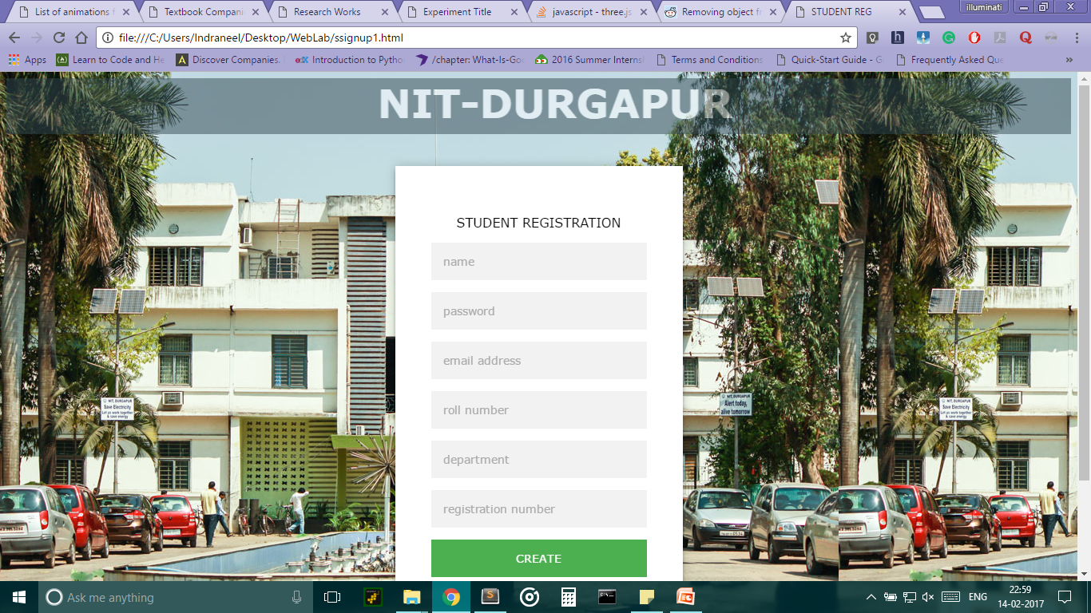
STUDENT LOGIN

Slide 20
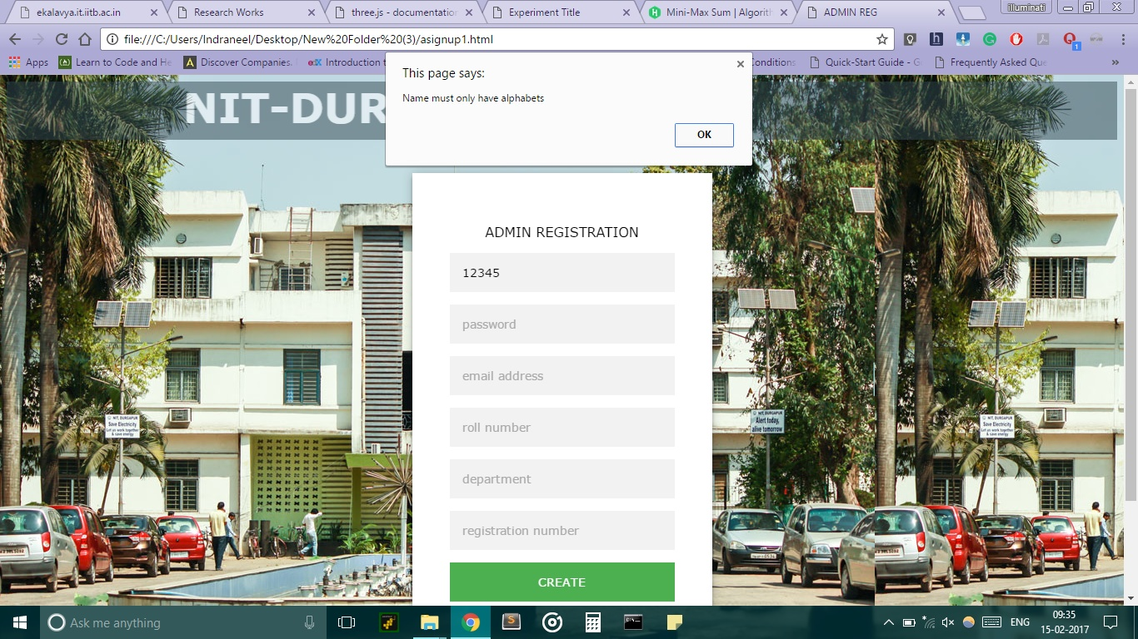
Form Validation

Slide 21

Form validation

Slide 22
Work done by 14/it/21
Created html code of student login page.
Created css code of student login page
Validation of student login page.

Slide 23
Work done by 14/it/31
Created presentation of the website.
Form validation.

Slide 24
Work done by 14/it/51
Form Validation of admin registration page.
Form validation of student registration page.
Validation of admin login page.

Slide 25
TASK TO BE DONE NEXT WEEK: 22/02/17
Database creation of website.
Admin display page after login.
Change display.

Slide 26
DAY 5 :01.03.2017
Work Done by:
14/IT/21
14/IT/31
14/IT/51

Slide 27
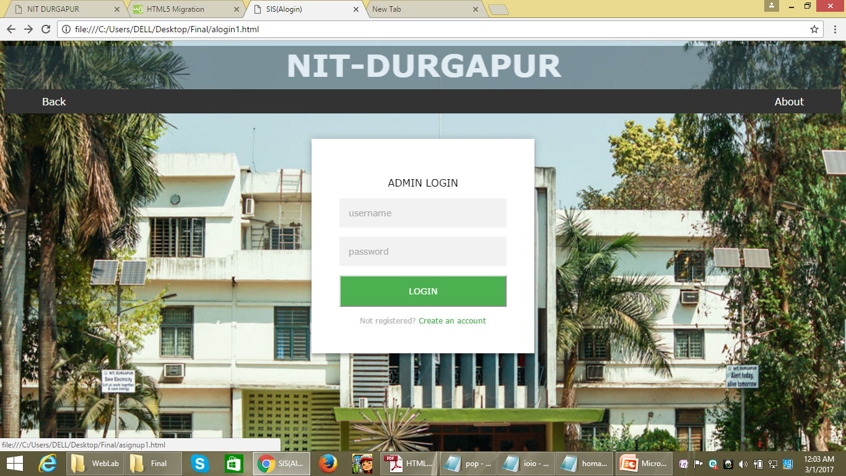
Creation of navigation bar

Slide 28
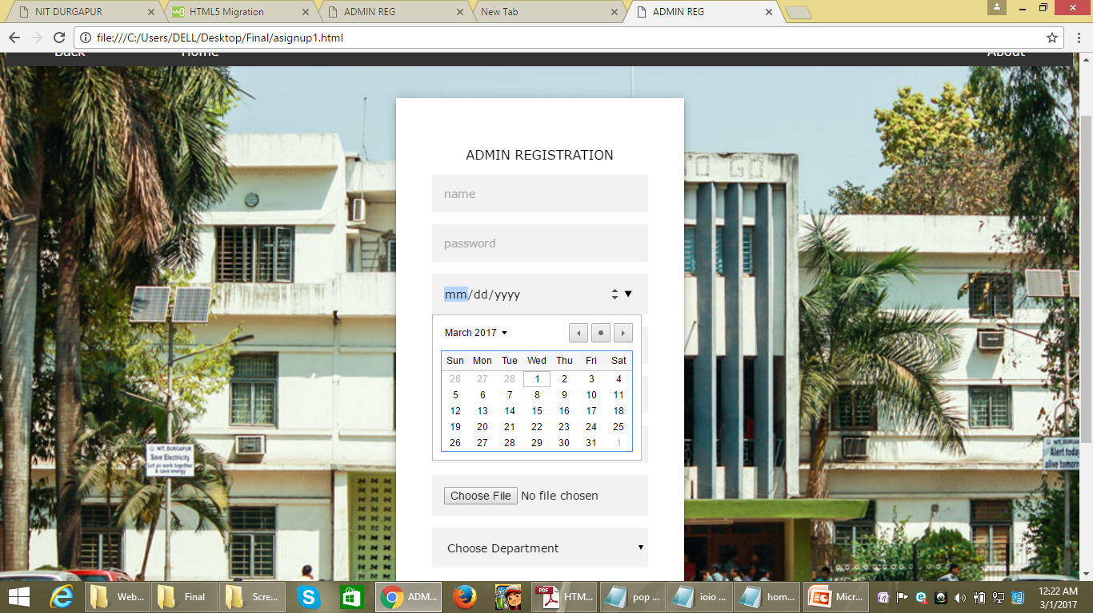
Adding Calendar Form

Slide 29
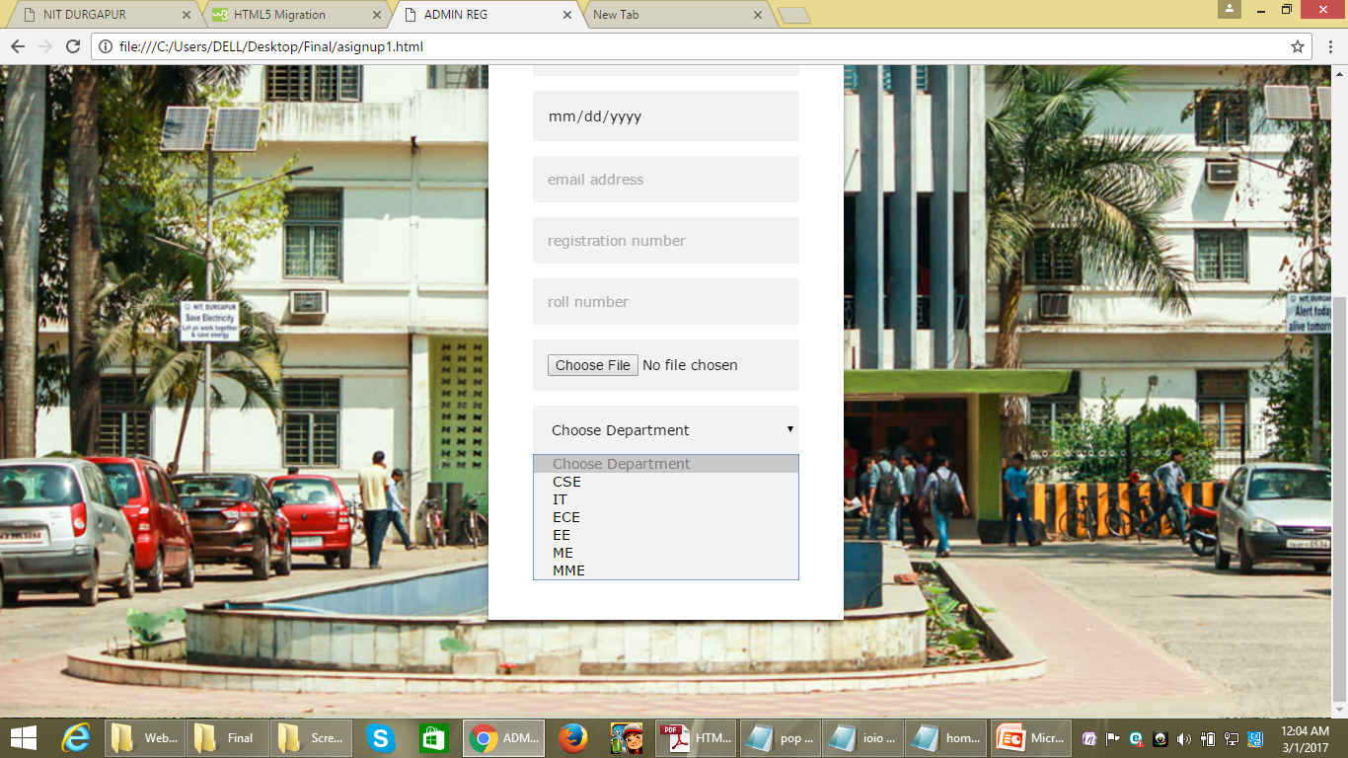

Slide 30
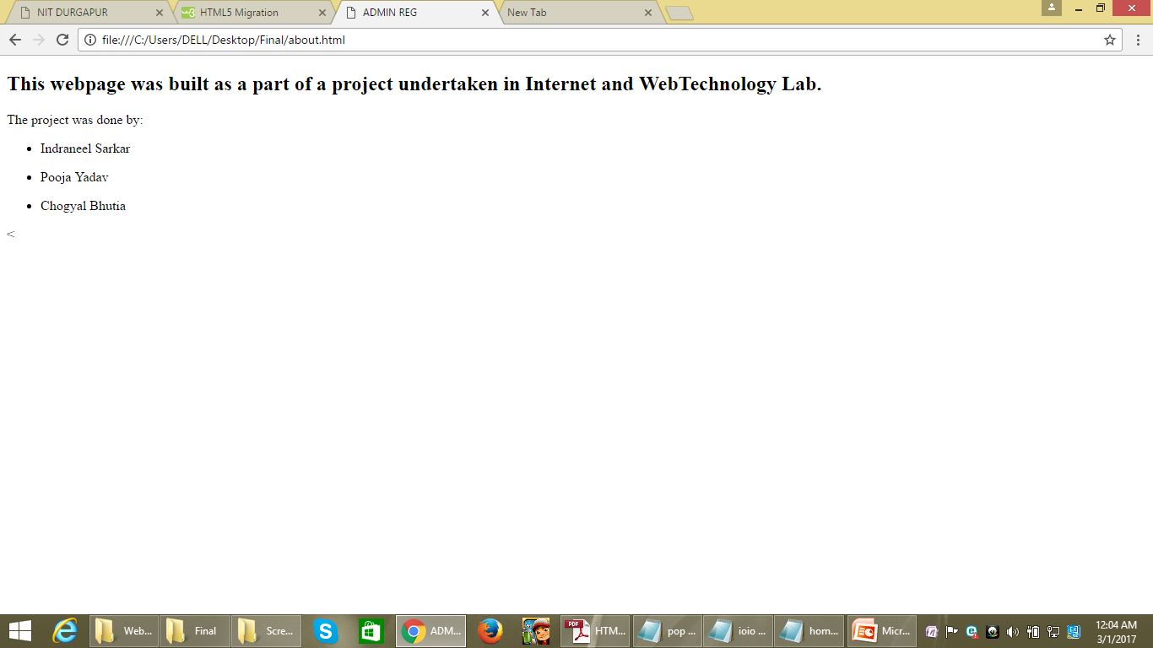
About form

Slide 31
Work Distribution
14/IT/21
Added navigation bar , calendar ,radio buttons to the page.
HTML and CSS code

Slide 32
WORK DISTRIBUTION
14/IT/31
Worked on html and css code
Presentation work.

Slide 33
Work Distribution
14/IT/51
Worked on html and css code
Form validation

Slide 34
TASK TO BE DONE NEXT WEEK(08-03-2017)
Database creation
Further modifying of the web page.

Slide 35
DAY 6 (DATE:08.03.17)
WORK DONE BY:
14/IT/21
14/IT/31

Slide 36
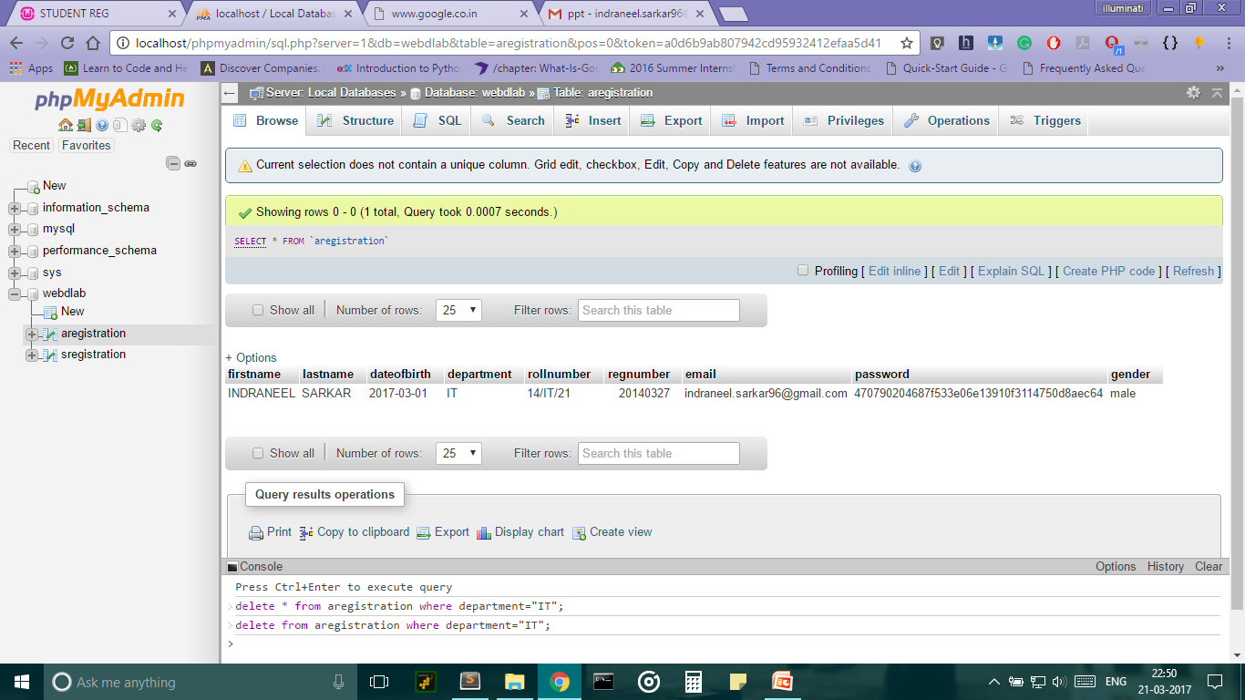
ADMIN REGISTRATION

Slide 37
WORK DONE:
Database connection (Admin registration page)
Further modified the web page
Worked on navigation bar implementation.

Slide 38
TASKS TO BE COMPLETED NEXT WEEK DATE:15.03.17
Database connection of student registration to the web page
Modification of the web page.

Slide 39
GROUP:20 dATE:23.03.17
ROLL NO:
14/IT/21
14/IT/31
14/IT/51

Slide 40
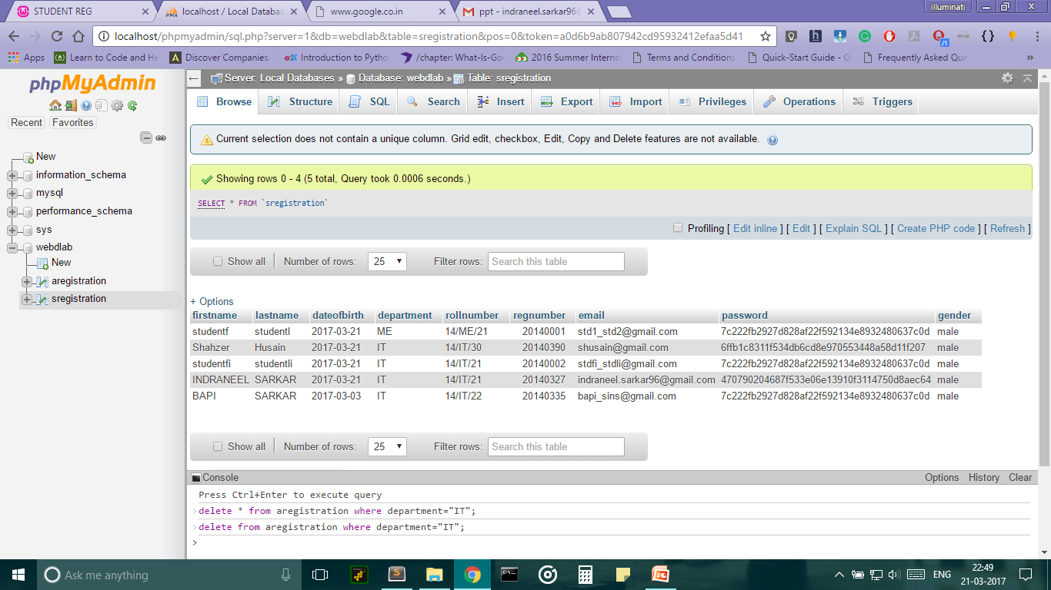
STUDENT REGISTRATION

Slide 41
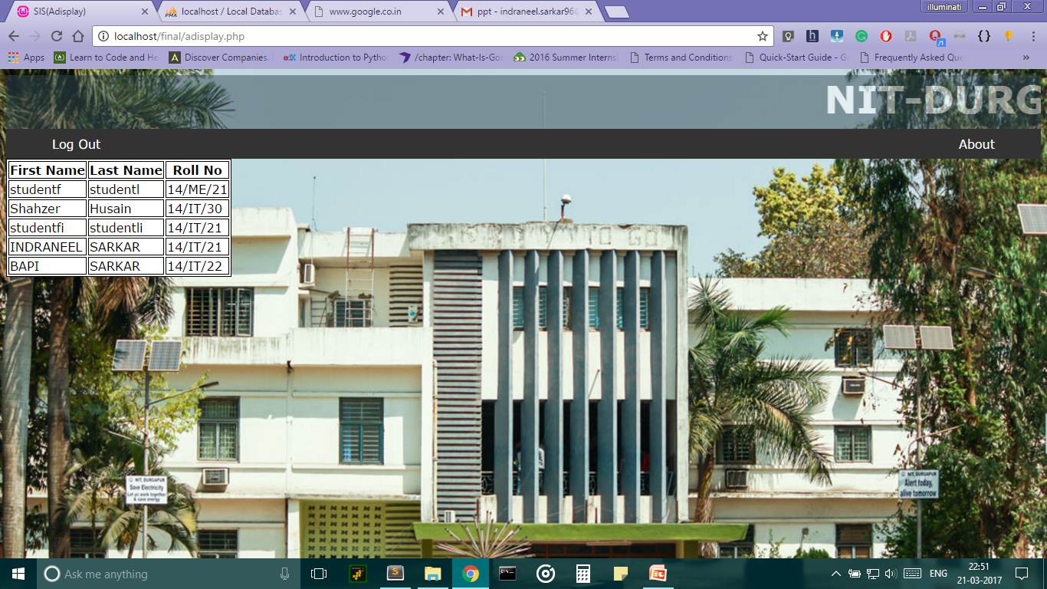
ADMIN Display panel

Slide 42
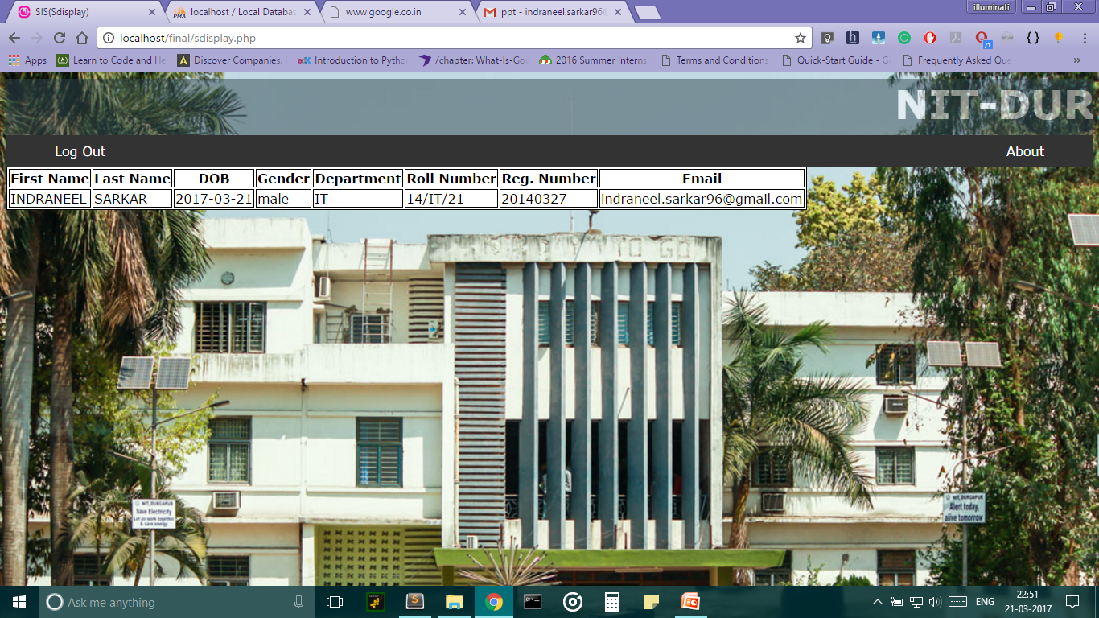
STUDENT Display panel

Slide 43
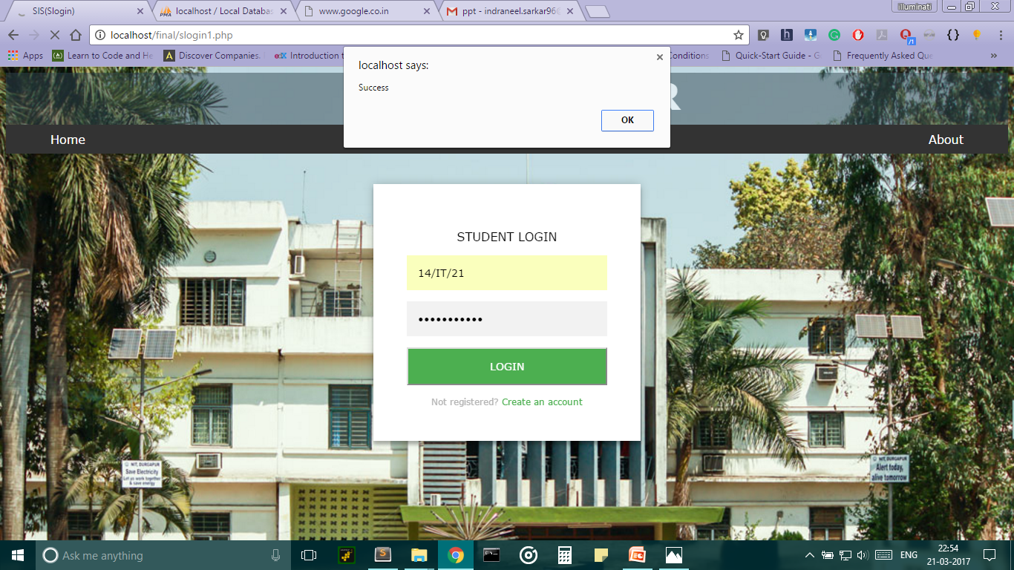
Student Login

Slide 44


Slide 45
WORK DONE:
Database connection to the page
Further modification to the web page
Presentation of the weekly work

Slide 46
TASKS TO BE COMPLETED NEXT WEEK(Date:29.03.17)
Adding few more details of the student to the student’s registration page.
Overall view of the project.

